Slide 1
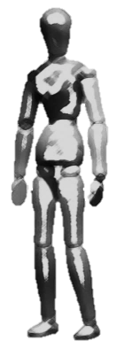
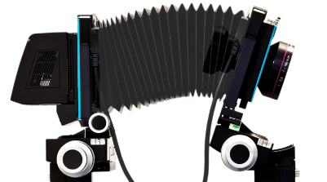
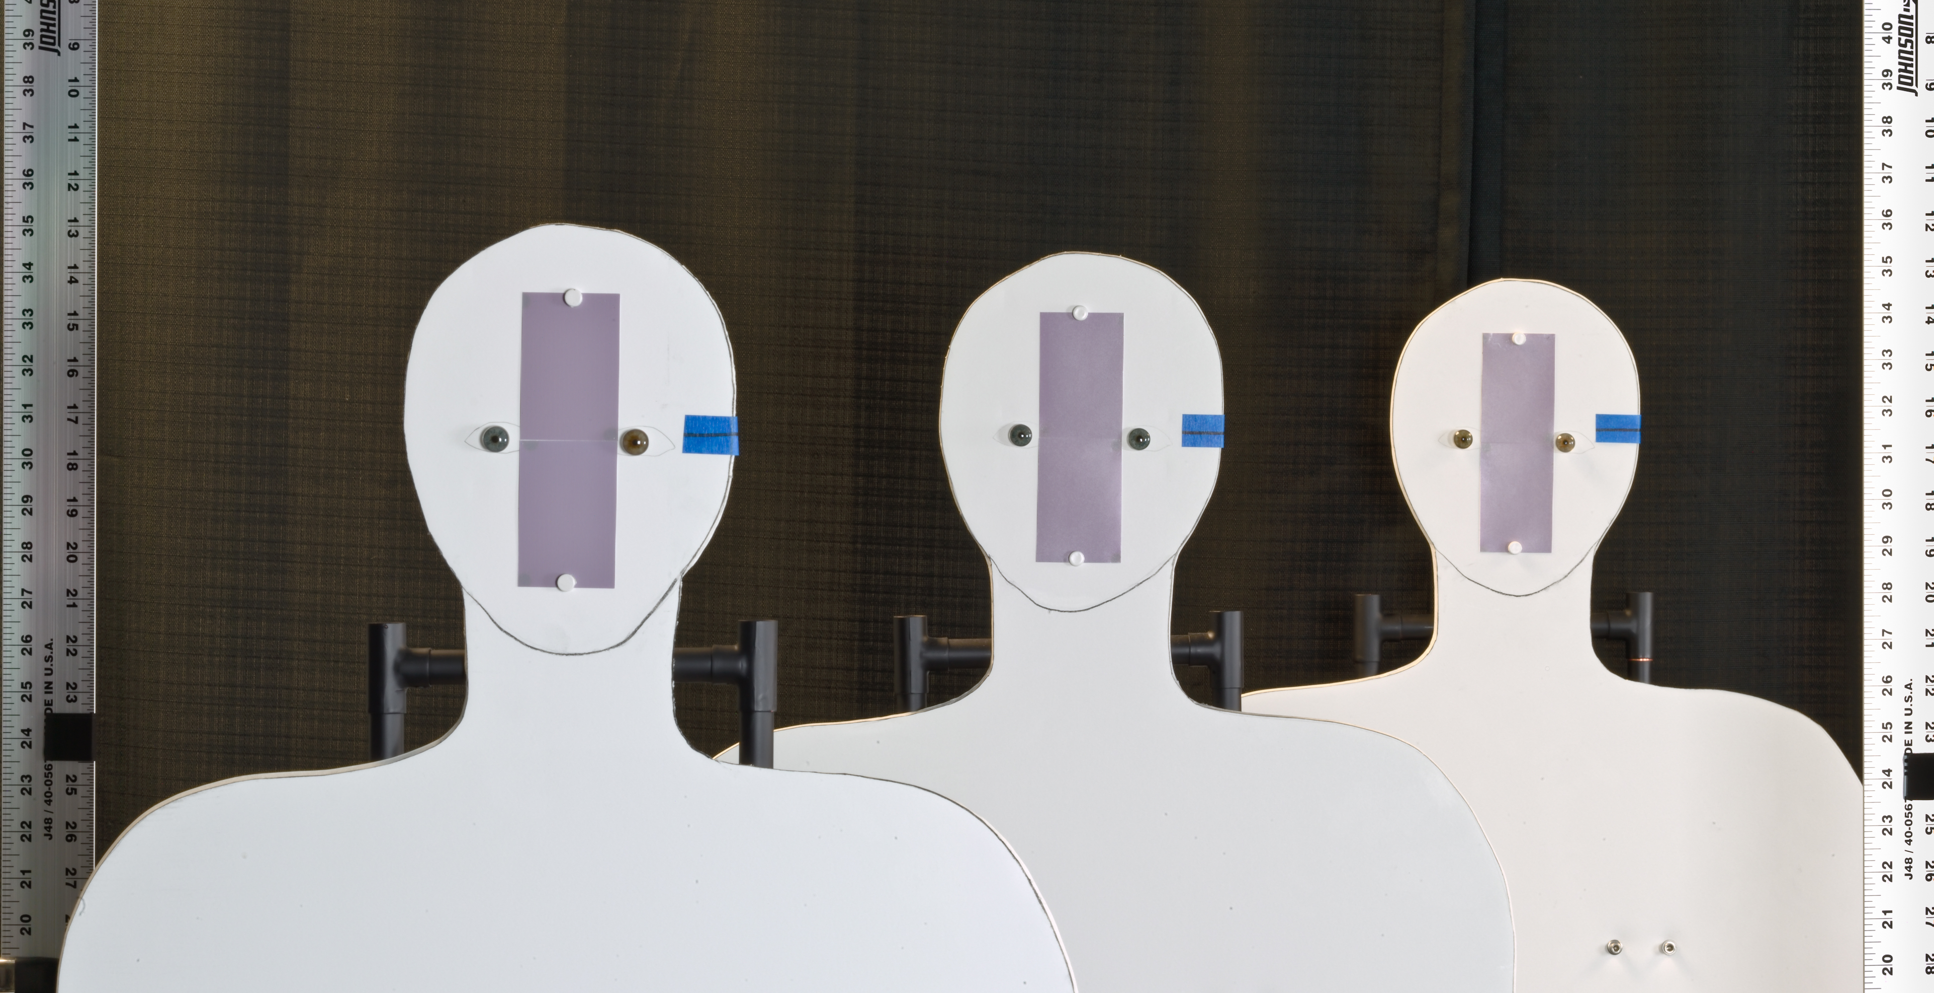
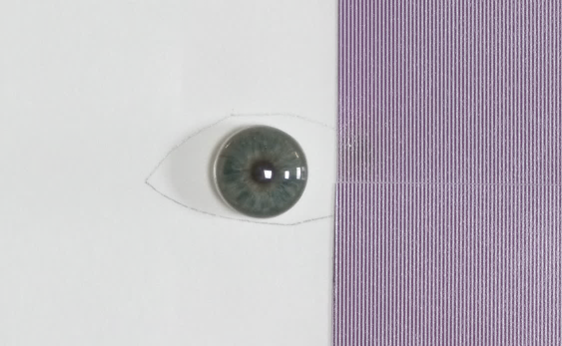
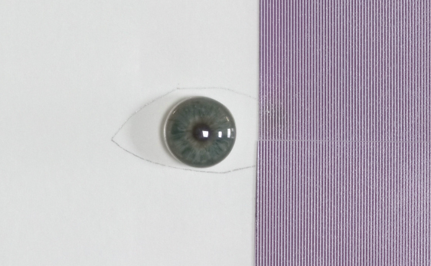
Demonstration of capture volume improvement using AFS in the laboratory
0.61 m
0.61 m
4.038 m
Setup
rear
middle
180 mm, F/8
near
Artificial iris
Ø 11 mm
Camera’s view
Pattern (2 lp/mm)
mm

Slide 2
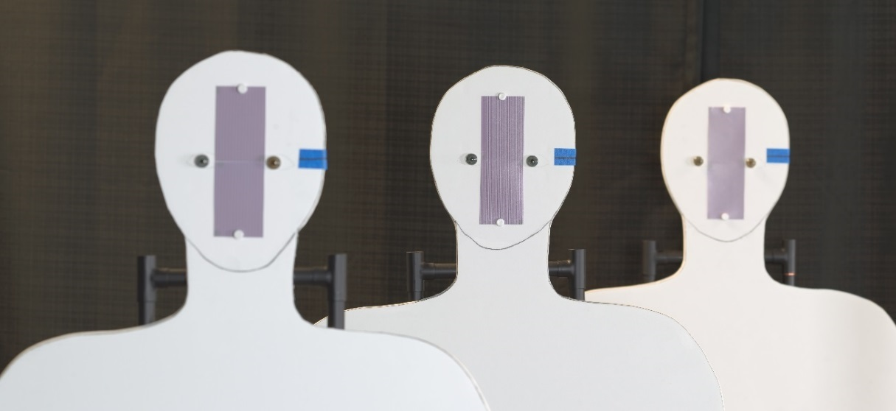
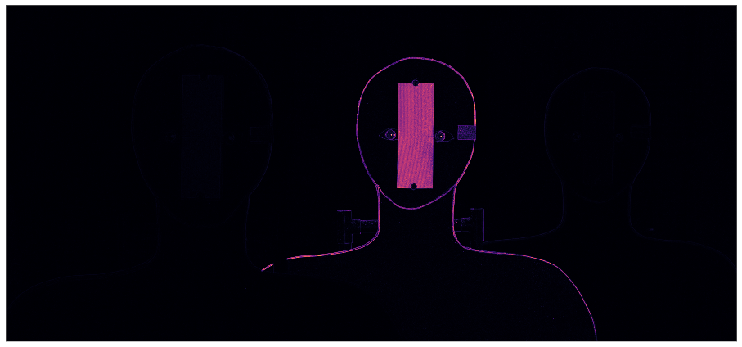
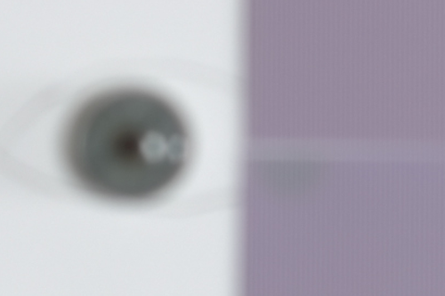
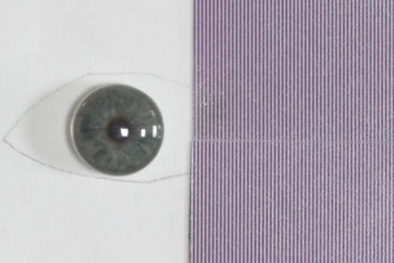
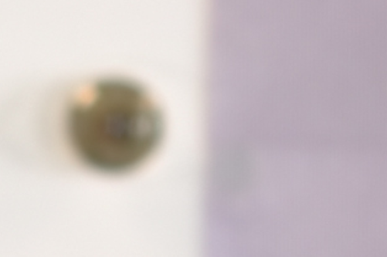
Traditional image capture at optimum aperture usually results in shallow DOF
Aperture: F/8 Exposure time: 0.77 sec Focused on: 4.04 m DOF: approx. 30 cm (for 2 lp/mm)
3.43 m
4.04 m
4.65 m
Focus measure
Notes:
Mention that the patches has been scaled differently to match ???

Slide 3
Strategy for capture AFS images
180 mm, F/8 lens tilted b/w -16° & -19° in increments of 0.5° about the entrance pupil center
Notes:
How to determine the angles
How to determine the image plane distance
How to determine
A line on how to restore the COP …
Empirically we found d = -5

Slide 4
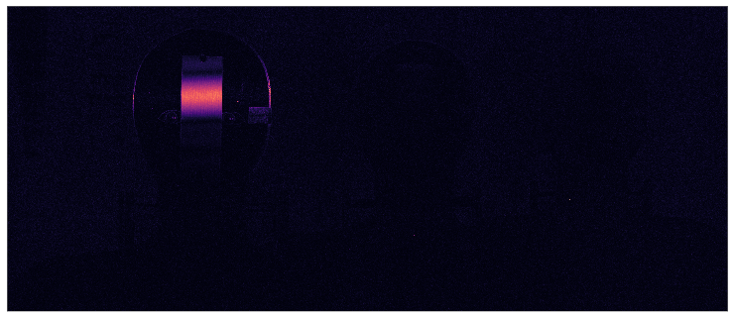
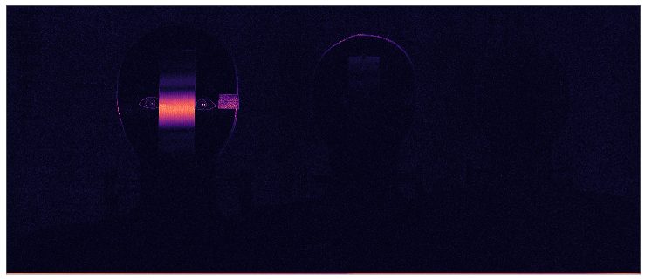
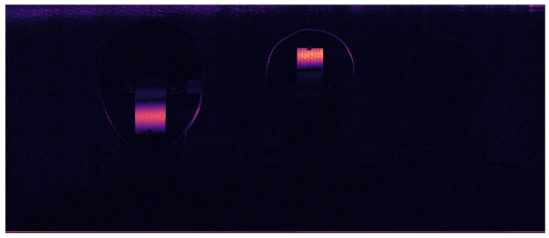
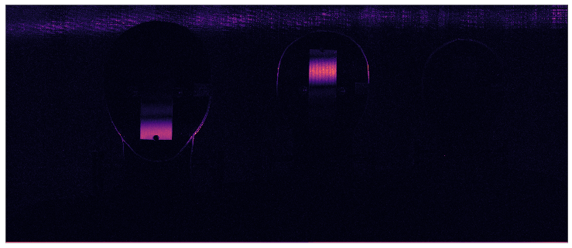
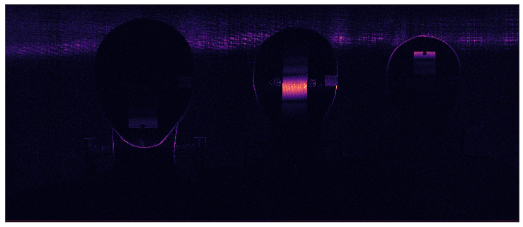
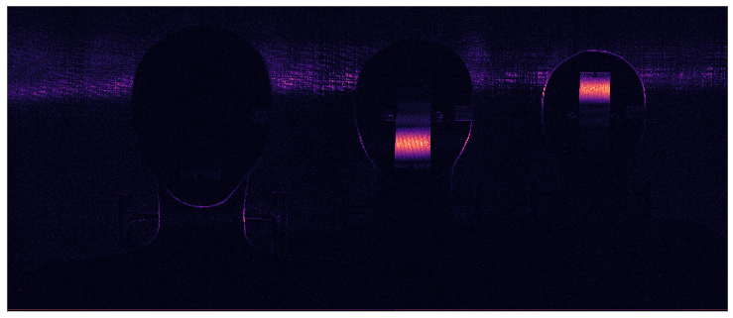
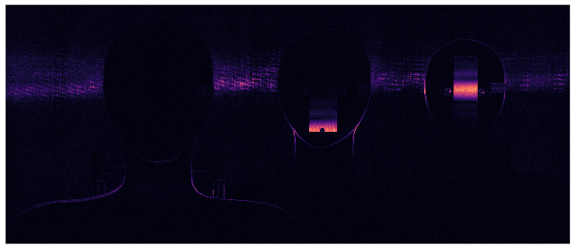
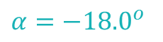
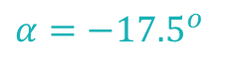
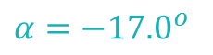
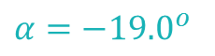
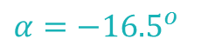
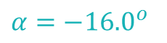
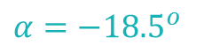
In-focus regions detected in the registered focal stack images using LoG filter shows different regions of the scene in focus
$$α=−{16.0}^{o}$$
$$α=−{16.5}^{o}$$
$$α=−{17.0}^{o}$$
$$α=−{17.5}^{o}$$
$$α=−{18.0}^{o}$$
$$α=−{18.5}^{o}$$
$$α=−{19.0}^{o}$$

Slide 5
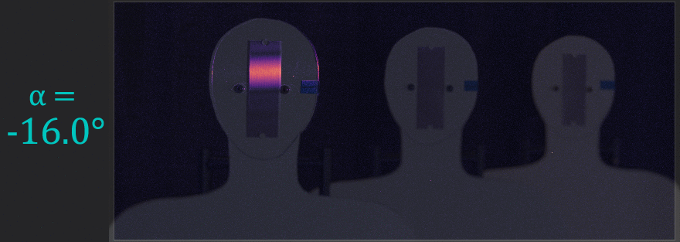
In-focus regions overlaid on intensity images shows
rotating the lens induces a rotation of the DOF in the object space

Slide 6
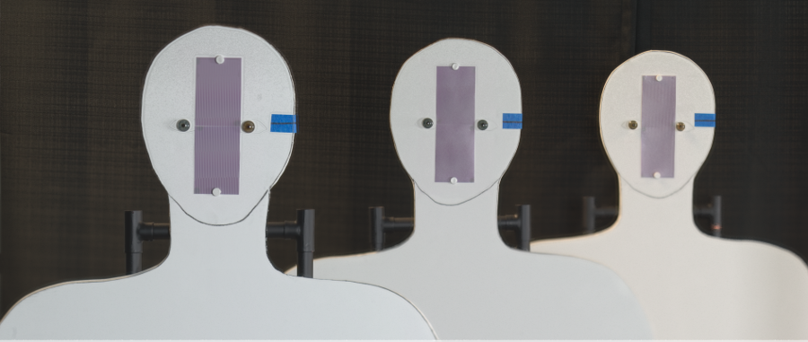
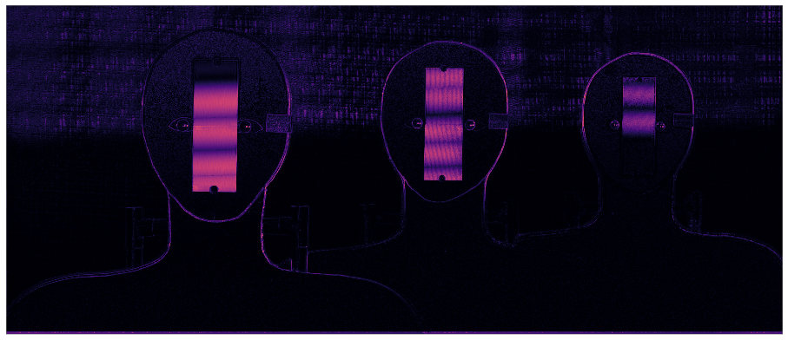
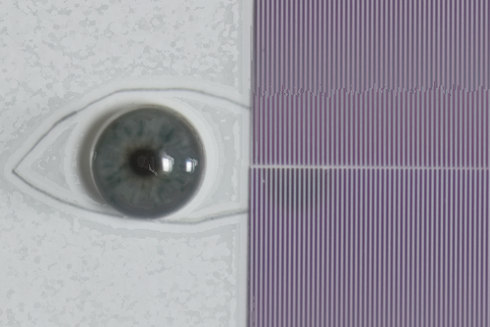
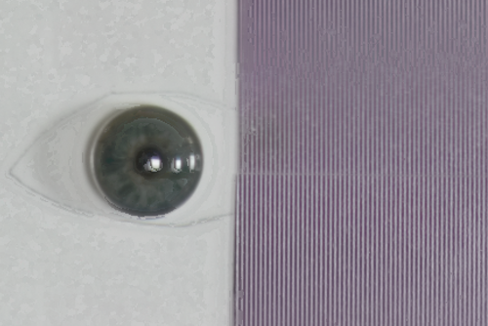
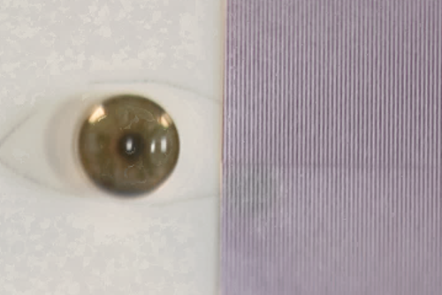
AFS composite image shows DOF extended beyond 1.2 meters
Aperture: F/8 (each image) Total exposure time: 5.4 sec DOF: greater than 1.2 m (for 2 lp/mm)
3.43 m
4.04 m
4.65 m
Focus measure
Notes:
Talk about the registration errors arising from the uncertainties of the experiment.

Slide 7
AFS produces at least 4x more DOF than conventional imaging
for a 2 lp/mm target at a standoff of 4 m
Near (3.43 m )
Middle (4.04 m )
Far (4.65 m )
Conventional capture at
F/8
AFS
Notes:
Mention that the patches has been scaled differently to match ???

Slide 8
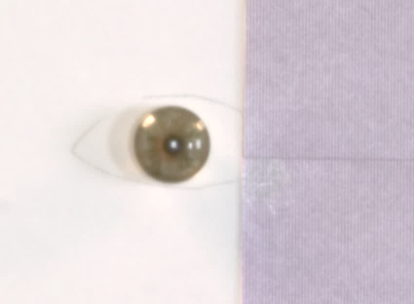
AFS is faster than conventional capture for equivalent DOF & exposure level. Therefore, subjects are less constrained within the extended capture volume.
Near (3.43 m )
Middle (4.04 m )
Far (4.65 m )
Conventional capture at F/22, T= 8 sec.
AFS
Total T = 5 sec.
Each T = 0.77 sec.
Notes:
Since the main comparision here is for the total time … I can probably scale the images of the eye patches

Slide 9
We can concluded that.
Notes:
Conclusion from the slide
Two parts (horizontally separated)
Just two sets of horizontal bar plots.
Compared to conventional imaging | Compared to the state-of-the art
How much DOF extension
Better in

